Slide 1



Slide 2

"Unleashing the Power of P300 Spellers: Elevating Performance through Cutting-Edge Feature Extraction Analysis"
BCI Spring Hackathon, April 28, 2024
Diptyajit Das, Bhawna Kapoor, Tanaya Das, Zahra Maleki, and Puneet Tomar
Email: tomarp@pm.me

Slide 3
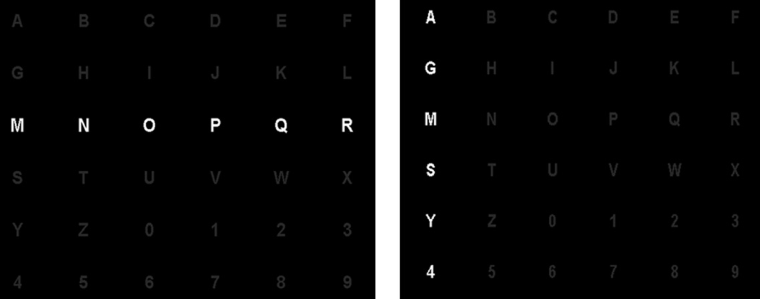
Problem Statement
Can we design a novel classifier that can improve P300 Speller performance based on features ?
P3/P300?
Prominent positive event-related brain potential (ERP)
SOTA
the row/column
Row/Column speller (RC)
Subjects paid attention to speller flashes with multiple character at once.
Time-variant Linear Discriminant Analysis (TVLDA)
Subjects: 5, EEG data: 8-channel, Sampling Rate : 250 Hz
TVLDA outperformed LDA classifier with a high accuracy (~90%)
[1] Ref. https://doi.org/10.1016/j.neulet.2009.06.045

Slide 4
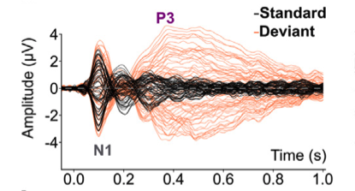
P300 speller
What is P3/P300?
Prominent positive event-related potential (ERP) in EEG.
Reflects brain activity approx. 300 ms after the target stimuli.
Popular in BCI paradigm: easy to detect, high accuracy and speed.
[2] Ref. https://doi.org/10.1016/j.clinph.2023.11.014.

Slide 5
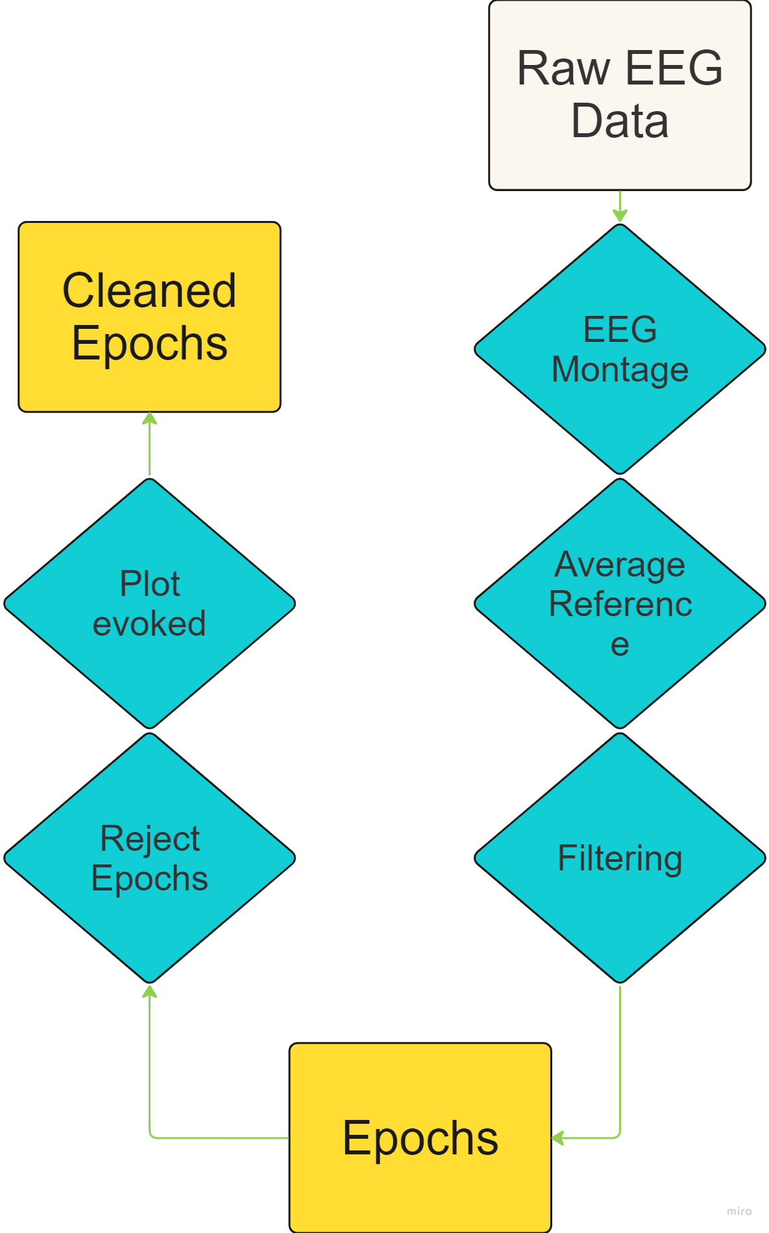
Pre-Processing EEG
Start
Steps performed:
MNE styled Raw object creation (raw data)
EEG montage/common average
Bandpass filtering ( 1-30 Hz )
Epochs creation (-0.1 to 0.8s)
Plot evoked for quality control

Slide 6
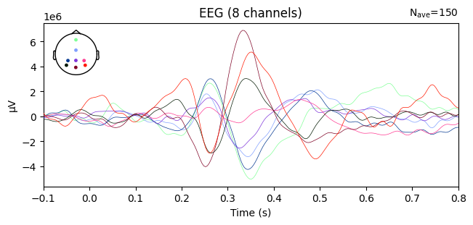
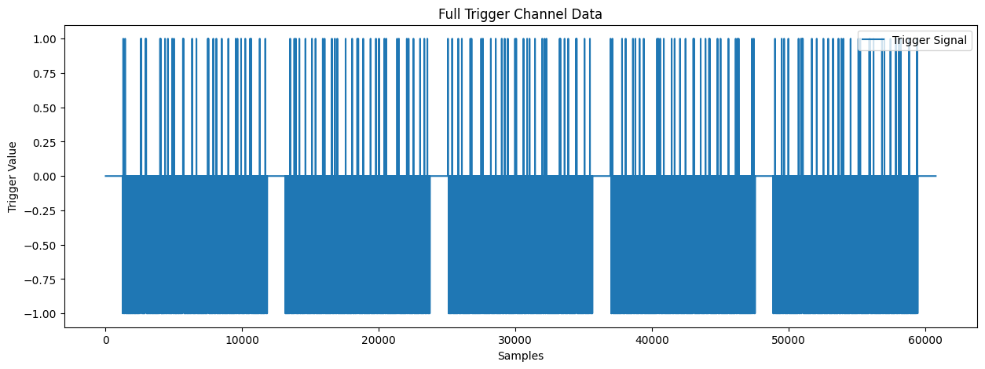
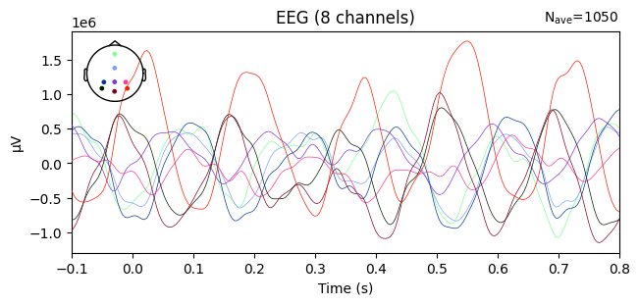
Evoked EEG plots
Plot 1: Evoked signal from one subject (target)
Plot 3: Trigger information
Plot 2: Evoked signal from one subject (non-target)

Slide 7
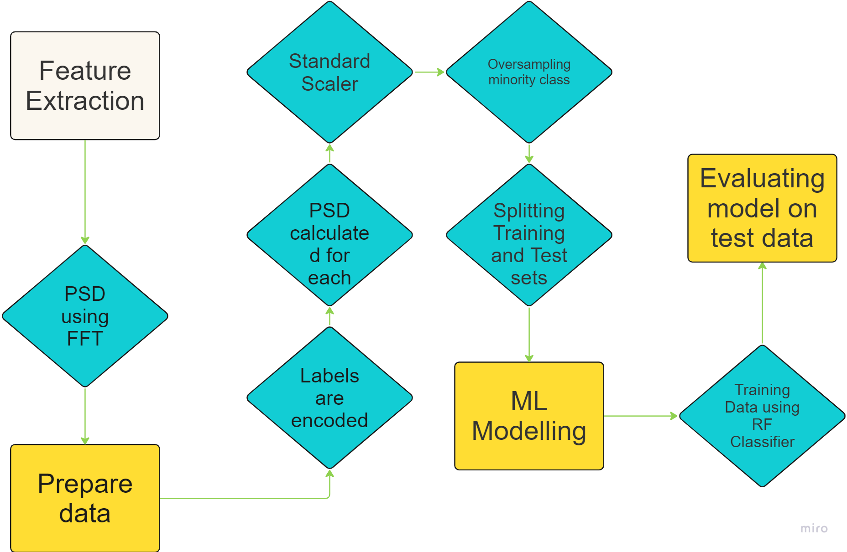
Pipeline Workflow
Start
Extracted Power Spectrum Density (PSDs) features
Normalization of features
Oversampling to address class imbalance
Defining a RFClassifier
Training of classifier
Evaluation of model
End

Slide 8
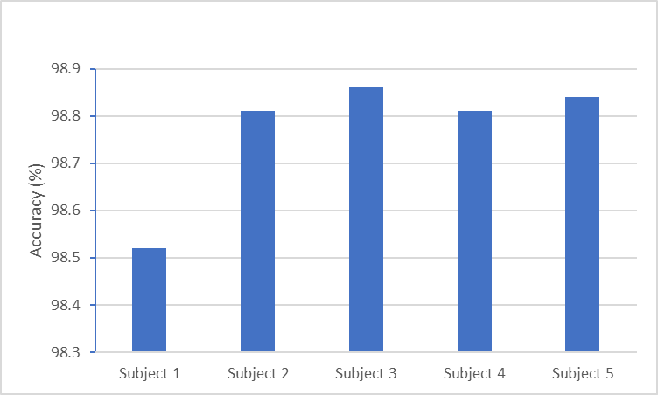
RESULTS (1)
All subjects achieved more than 98% accuracy using RF classifier
Plot 5: Accuracy of RF classifier for each subject

Slide 9
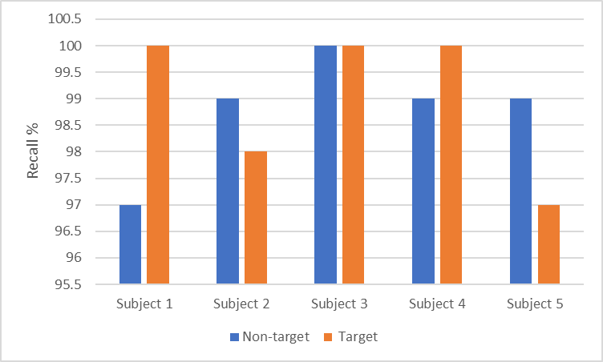
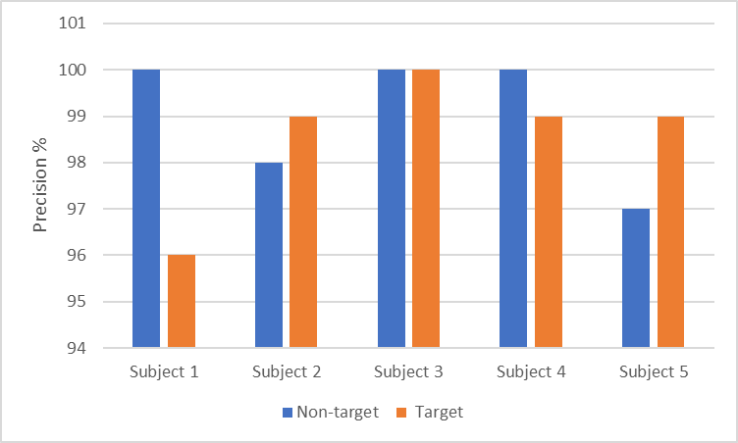
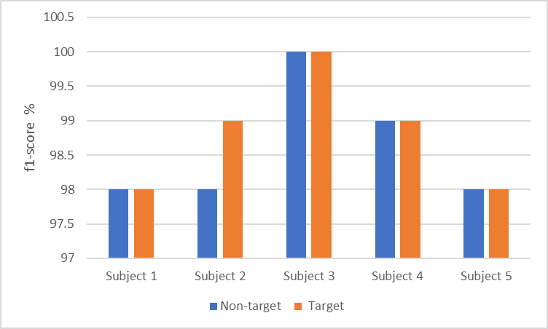
RESULTS (2)
Plot 6 : Metrics obtained for RF classifier

Slide 10
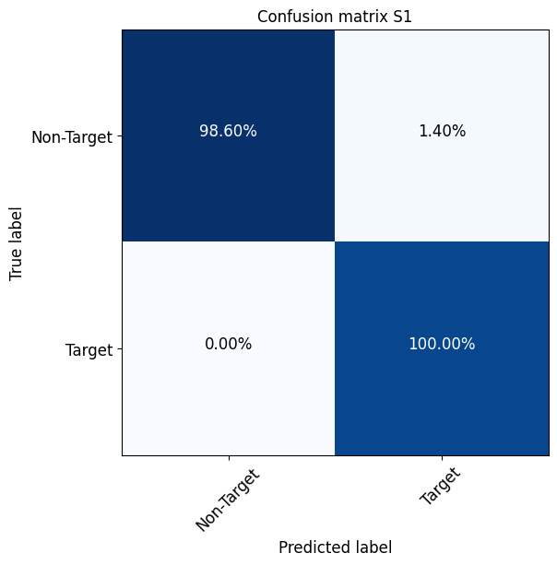
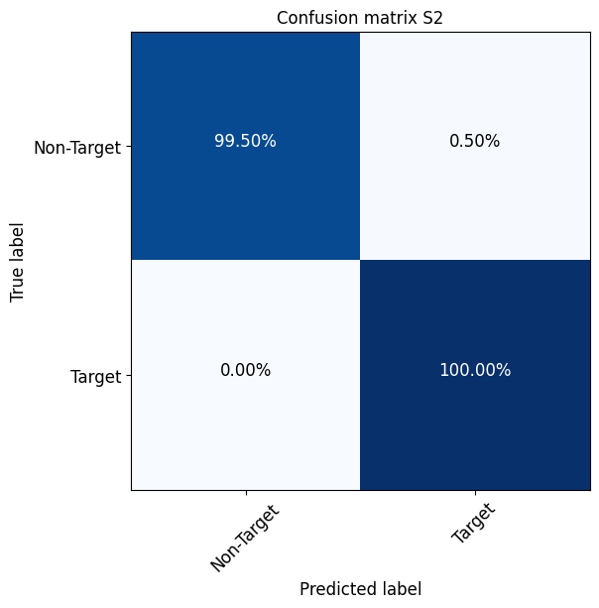



RESULTS (3)
Plot 7: Confusion matrix obtained for each subject

Slide 11
Conclusion
Future Work
Achieved the best possible performance (ACC > 98%) using RF classifier
Performance of RF > Logistic regression > TVLDA
Different combination of TD & FD features can be evaluated
Model can be trained on collective vs individual samples

Slide 12

Code is available at github
Diptyajit Das, Bhawna Kapoor, Tanaya Das, Zahra Maleki, and Puneet Tomar
Email: tomarp@pm.me

Slide 13
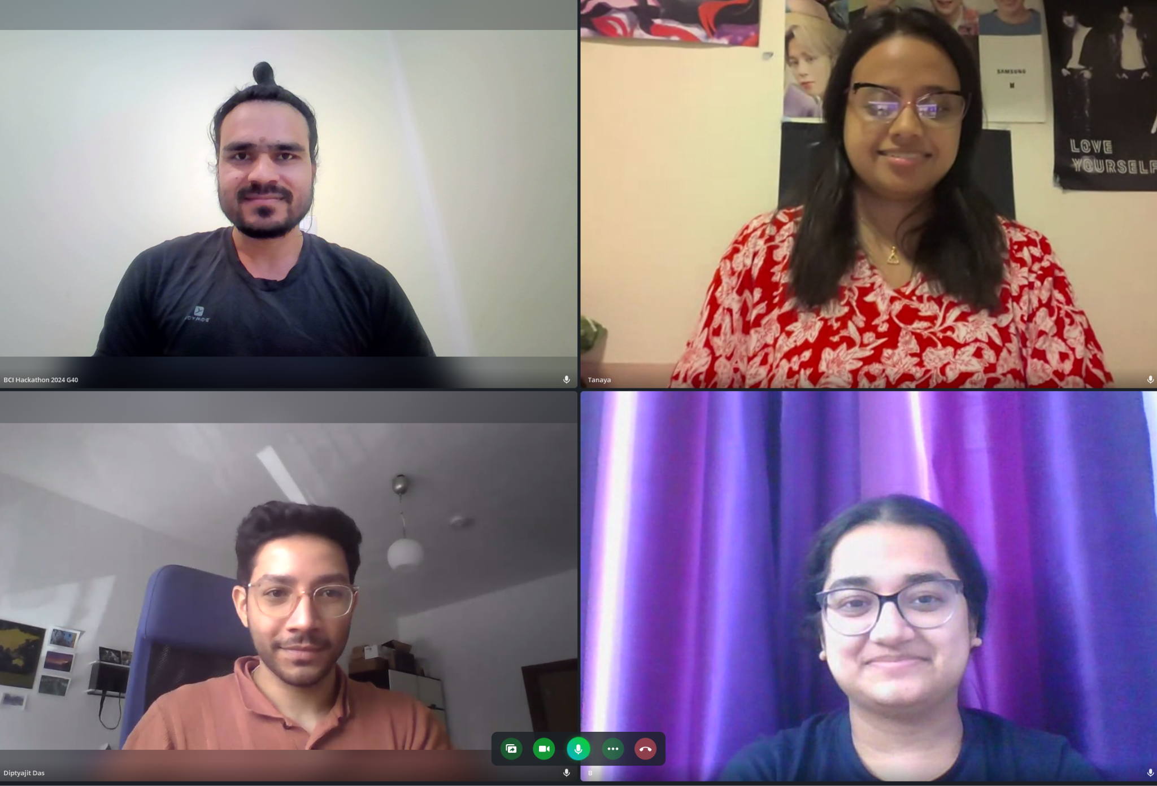
We are Neuroide !!

